Slide 1
WEATHER FORECASTING USING PYTHON
BATCH-07
RENUKA PATIL-2GI20IS029

Slide 2
SALIENT FEATURES :
Design and Develop an API which analyses Wind speed, Wind direction, Temperature and provides with data using Python.
Observe, measure, and record the basic elements of weather.
Observe, measure, and record data on the basic elements of weather over a period of time (i.e., precipitation, air temperature, wind speed and direction, and air pressure).
Interpret recorded weather data for simple patterns.
Observe and record effects of air temperature on precipitation (e.g., below freezing results in snow, above freezing results in rain).
Observe and determine future climate changes.

Slide 3
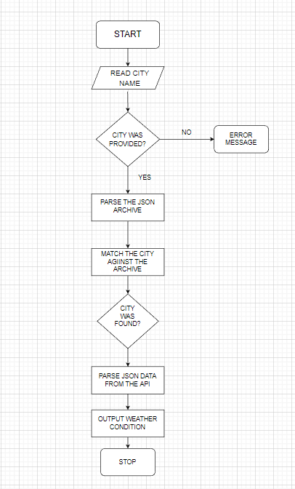
METHODOLOGY :

Slide 4
MODULES USED:
To develop this application, we need three modules- tkinter, requests and JSON.
The Tkinter provides various controls, such as buttons, labels and text boxes used in a GUI application. These controls are commonly called widgets. This framework provides Python users with a simple way to create GUI elements using the widgets found in the Tk toolkit.
The requests module makes an HTTP request to the specified web page using Python and returns a response object. There's no need to manually add query strings to your URLs, or to form-encode your POST data. We can install this using the pip tool.
The JSON module is mainly used to convert the python dictionary above into a JSON string that can be written into a file. While the JSON module will convert strings to Python datatypes, normally the JSON functions are used to read and write directly from JSON files.

Slide 5
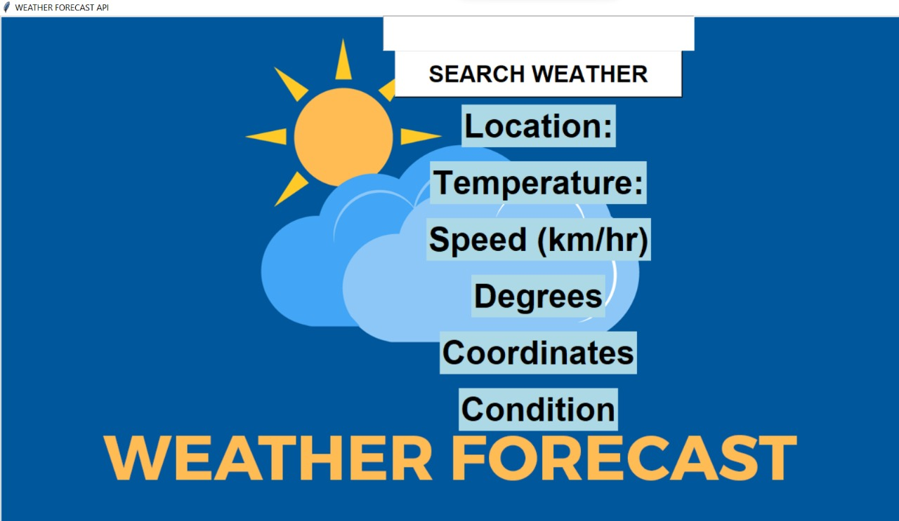
OUTPUTS :

Slide 6
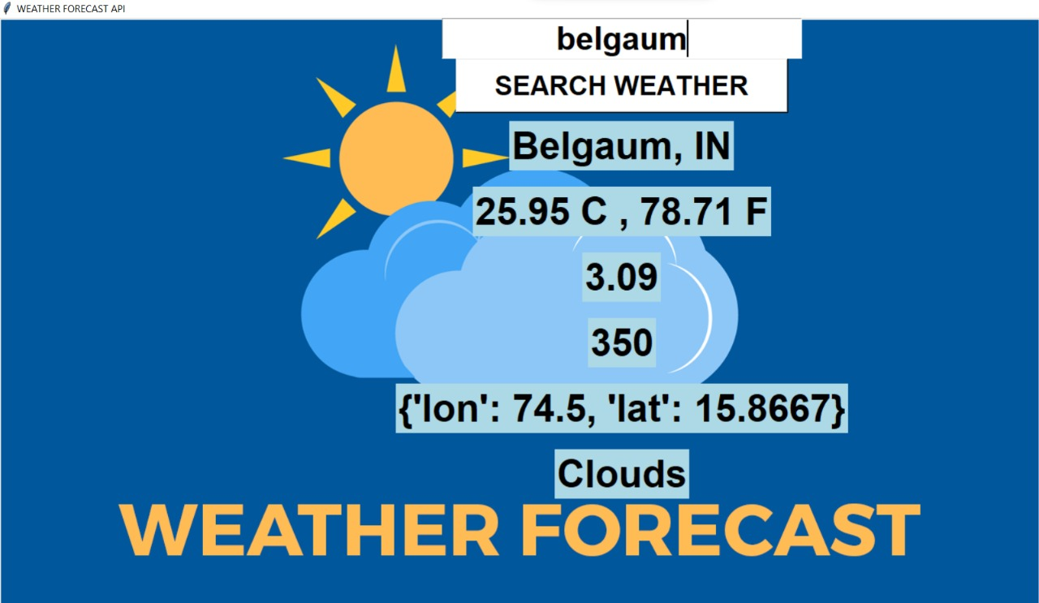
.

Slide 7
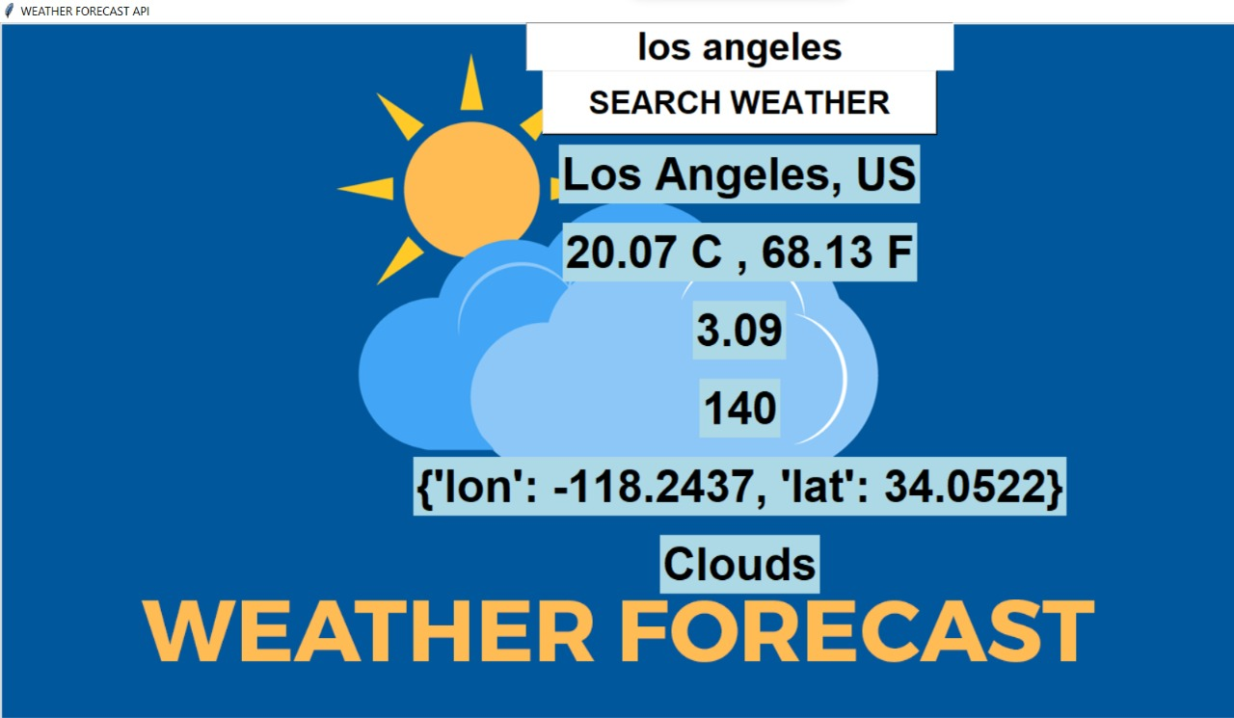
.

Slide 8
Advantages of Weather forecasting:
Seasons and nature play a major role in agriculture and farming.
Farmers didn't have a better understanding of weather forecasts before, so they had to rely on estimates to do their jobs
Weather Forecasting is crucial since it helps to determine future climate changes.
Improve the Transport and Tourism Businesses.
Flood Prevention. Boost Energy and Agriculture Sectors. Weather forecasting relies on different systems and products that can be used to measure atmospheric conditions.
Applications:
includes papers on significant weather events, forecasting techniques, forecast verification, model parameterizations, data assimilation, model ensembles, statistical postprocessing techniques, the transfer of research results to the forecasting community, and the societal use and value of forecasts.

Slide 9
THANK YOU
.

